Slide 1

Considering S.45 - Comparison of Physician to Nurse Practitioner Training and Education
Ed Evans, M.D.

Slide 2
We Agree with our NP Colleagues that Scope of Practice Should be Commensurate with Education and Training……
So, Let’s Examine the Differences

Slide 3
Entrance Requirements to Medical School vs. NP Program
Medical School
NP Program
Students must have a 4-year degree and complete all science prerequisites
Must have a very competitive GPA (MUSC 3.7 average)
Very competitive MCAT score (MUSC 511 average) – Students study for months prior to taking this test
Medical Schools look for Clinical Experiences as a Part of the Application Process
Interview Process for Admission
Very low acceptance rate to medical school (MUSC – 4.9%, USC-Columbia – 3.5%, USC-Greenville – 2.5%)
Must have bachelors or RN – general education and nursing education – focus on practice of nursing, not medicine (patient assessment like monitoring vital signs, medication administration and treatments as ordered by prescribers, development and implementation of nursing care plans, patient education)
In 2019, 20 NP schools in the country had a 100% acceptance rate*
Acceptance rate for MUSC DNP program is 98.2%**
At least 22% of Family Nurse Practitioner students enter “direct-entry” programs—meaning they have no prior nursing experience.
* Nursing Master's Programs With the Highest Acceptance Rates
** Medical University of South Carolina Doctor of Nursing Practice (DNP)

Slide 4
Standardization of Education
Medical School
NP School
Early 1900s review by the Carnegie Foundation found tremendous inconsistency in medical education
120 years ago, the Flexner report highlighted deficiencies in medical education, and as a result many medical schools were closed – specifically rejected the ‘apprenticeship model’ of training
Rigorous medical school accreditation standards of today were born out this report – today HIGHLY standardized
No online medical schools
New Discipline – Accreditation Process began in 1998
Within 3 months of this process being introduced, 300 NP programs were approved
Today, over 400 schools
In 2019, 60% of NP programs are 100% online

Slide 5
Education Accreditation Process
Medical School
NP Program
Licensing Commission for Medical Education (LCME) for MDs and COCA for Dos
Written Standards –
Prepares students for practice of medicine
Ensures 100% of students learn sufficient breadth to be authority in the field of medicine
Guarantees that 100% of students learn the process to accurately diagnose patients
Identifies and remedies gaps in knowledge
Explicitly teaches students to recognize their limits
Accrediting body could show up at any time and require medical school to prove students can meet these standards
Training programs have various accrediting bodies
Commission on Collegiate Nursing Education (CCNE)
Accreditation Commission for Education in Nursing (ACEN)
Accreditation Standards are not as clear so harder to hold schools accountable for student knowledge and preparation
Personal Experience Teaching in NP Program in SC

Slide 6
Testing for Competency/Safety to Move Into Clinical Training with Patients
Medical School
NP Program
First 2 years are classroom and laboratory learning (physical exam skills and in-depth science)
After first two years of medical school, medical students must pass 1st of a 3 step-medical licensing exam to demonstrate they have gained the knowledge to safely move forward into clinical education
None

Slide 7
Clinical Training During Educational Program
Medical School
NP Program
3rd and 4th years of medical school are 3,000 hours each of hands-on patient care with direct physician supervision
Prepares students to have clinical authority in the practice of medicine
6,000 clinical hours
No independent practice
500 (minimum) to 750 hours
Average grad has 686 hours
Much, and in some cases ALL of this can be online, without supervision of physicians or NPs
Some psychiatric NP programs allow 100% of clinical training via telehealth, yet certify graduates to manage patients “across the lifespan,” including children with mental illness.
Personal Experiences as NP Preceptor

Slide 8
Supervision During Clinical Training
Physicians
Nurse Practitioners
Every encounter is supervised and/or reviewed by physician faculty
Team-based care is emphasized; new docs often work with NPs in training
Commonly find their own rotations
No standardization of what patient experiences are required
My experience
“80 hours of OB…”

Slide 9


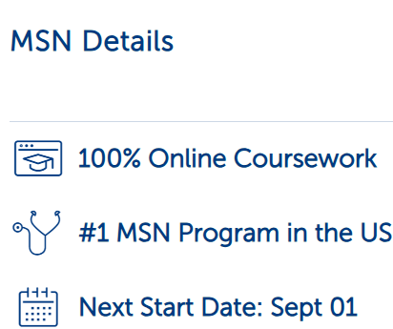




Examples of NP Programs
Master of Science in Nursing
Our CCNE-accredited program can help set you apart even further. Designed specifically for working registered nurses with a BSN, our program combines online coursework with practicum experiences. In as few as 18 months, or in as few as 27 months for the Nurse Practitioner (NP) specializations, you’ll be ready to take your next step as a nursing leader and into advanced practice.
Earn Your MSN in as Few as 6 Months
Expand or enhance your nursing practice

Slide 10
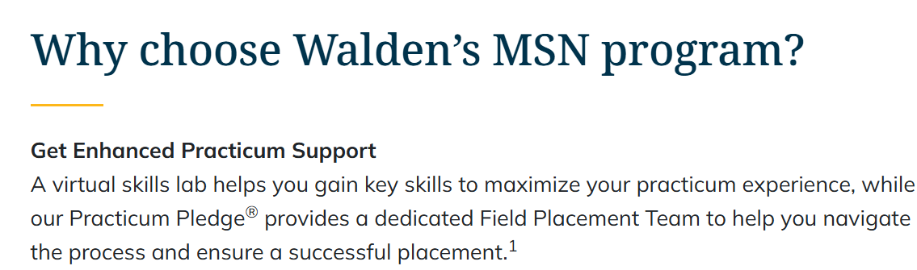
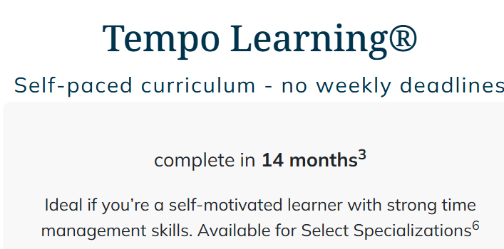
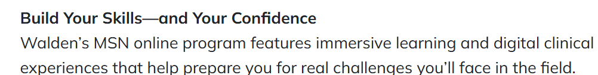



Examples of NP Programs

Slide 11
Patient Experiences in Clinical Training During Schooling
Medical School
NP Program
“Large number of students reported never experiencing some clinical tasks during their training including mental health assessment, ordering diagnostic tests and performing primary care procedures.”
Further:
Only 64% said they did more than 10 comprehensive health histories.
Only 69.4% said they did more than 10 comprehensive physical exams
Only 64.1% said they ordered diagnostic tests more than 10 times
And only 60.8% said they developed a differential diagnosis for geriatric patients during their clinical training.
IN ENTIRE NP TRAINING…
***https://www.journalofnursingregulation.com/action/showPdf?pii=S2155-8256%2821%2900021-1
Due to Standardization in Medical School, medical students in South Carolina (and across the nation) will often –
Perform 10 comprehensive health histories
Perform 10 physical exams
Order 10 diagnostic tests
Develop a differential diagnosis for a geriatric patient……
IN ONE WEEK…

Slide 12
After School, Residency Training
Physicians
6,000 from medical school plus…
Nurse Practitioners
Minimum residency is 3 years
Up to 7 years or more
Some specialties require a fellowship beyond residency
ACGME limits the number of hours a resident can work to an average of 80 hours per week (some weeks may be 60, some 100)
None – Enter Job Market

Slide 13
ACGME Residency Accreditation
The Accreditation Council for Graduate Medical Education must accredit every residency program. Sample accreditation requirements for a family medicine residency include for every resident:
A minimum of 1,650 in-person out-patient encounters (where the resident is obtaining the history, completing the physical exam, developing a medical diagnosis, ordering tests, prescribing medication if necessary - or discerning if a medication is not correct to prescribe).
600 hours and 750 patient encounters dedicated to hospitalized adult patients
200 hours and 250 patient encounters dedicated to hospitalized (or emergency care) pediatric patients
200 hours and 250 patient encounters with children and adolescents in the clinic setting
100 hours and 125 patient encounters specifically for geriatric patients
TOTAL HOURS DURING RESIDENCY ARE BETWEEN 10,000 and 16,000

Slide 14
Total Clinical Training (Education and Post-Graduate)

Slide 15
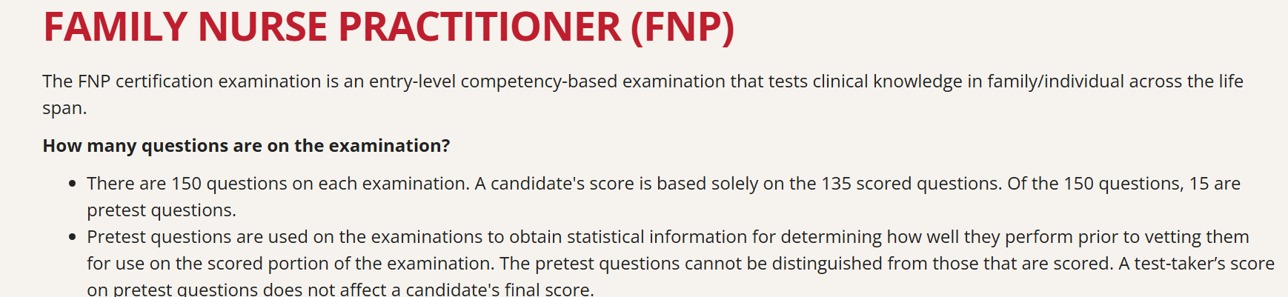


Testing for Competency
Physician
Nurse Practitioner
Step 1 Test – After first 2 years of medical school
Step 2 Test – After third year of medical school/first year of clinical rotation
Step 3 Test – After first year of residency
Initial Board Certification
Maintenance of Board Certification with exam every 10 years
Take 1 Entry- Level Certification Exam
Ex - Family Nurse Practitioner (FNP), Adult Gerontology NP, Emergency N, Psychiatric Mental Health NP

Slide 16
Comparing Competency….
For 5 years, some Doctorate Nurse Practitioner (DNP) candidates took the Step 3 exam, given by the NMBE, but with some of the clinical sections omitted on the exam. This is the only test that is well validated and tests clinical reasoning.
The DNP candidates who took it were far better educated than the standard NP students because they had been given at least 9 months of clinical rotations. This is as opposed to the disorganized 500 hours of clinical shadowing that typical NP students get.
The result was that, while 98% of physician candidates passed, only 42% of these more educated NPs passed.
*Al-Agba and Bernard, Patients at Risk, 2020.

Slide 17
Practice Within Certifications/Board Specialties
Physicians
Nurse Practitioner
NPs are not limited to practicing within certification, so Family Nurse Practitioner (FNP) could practice within any specialty – oncology, cardiology, rheumatology, orthopedic surgery, neurology – without obtaining any other specialty training or certification
While SC AHEC data reports 70% of NPs are practicing in primary care because they are FNPs, that is not true because many are practicing in other specialty areas
According to a recent study published by KFF Health News, while 90% of NPs are certified to work in primary care, only about 1/3 choose that field of practice*
*Like Doctors, More Nurse Practitioners Are Heading Into Specialty Care - KFF Health News
Only practice within area of completed residency or board certification
Do not switch specialties without completing residency/fellowship in another specialty

Slide 18



Even with S.45, Physicians are Still Far More Trained
PASSAGE OF S.44 & S.45
UNDER CURRENT LAW
Physicians
Nurse Practitioners Physician Assistants
Physicians
Nurse Practitioners Physician Assistants
20X
EDUCATION
Physicians have the highest level of education and 20 times the clinical training.
EDUCATION
4 years
2–3 years
2–2.5 years
4 years
2–3 years
2–2.5 years
RESIDENCY
RESIDENCY
60%
3–7 years
No residency
No residency
3–7 years
No residency
No residency
of nurse practitioner programs in 2019 were mostly or completely online.
Physicians must endure standardized, rigorous training to practice independently.
TRAINING
10,000–16,000 hours
500–720 hours
2,000 hours
TRAINING
10,000 - 16,000 hours
2,500 - 2,720 hours
4,000 hours
Even with an additional 2,000 training hours, it does not equate to physician requirements. NPs and PAs are not tested for competency, nor is their training standardized.

Slide 19
S.45’s 2,000-Hour Requirement
No standardization or specific requirements for 2,000 hours
No test or guarantee of competency for 2,000-hour experience
Does not control for the type of program someone graduated from – 100% online, direct entry from undergraduate nursing school
Only guarantees someone has graduated with a masters in nursing and has had 2,000 post-graduate hours of some type of clinical exposure – but allows for an NP to diagnose, treat, and prescribe without any physician involvement
NPs want to claim all hours of clinical training, including those as an RN, as having prepared them for independent practice; however, what matters are the hours that prepare them to diagnose, treat and prescribe – physicians don’t count hours as EMTs, CNAs, or shadowing programs in undergrad to prepare for medical school application process
S.45 would allow NPs to switch specialties and practice independently without any additional training

Slide 20
Realistic Example Under S.45
22-year-old graduates with a bachelor’s in nursing where they have only had clinical hours in the practice of nursing (taking vital signs, administering medication ordered by others, patient education) – not how to diagnose, treat, and prescribe
22-year-old immediately applies to and is accepted into an NP program with a 100% acceptance rate that is 100% online
24-year-old completes NP program with exposure to the average 686 clinical hours, but no requirements or standardization of what was learned in this time frame
24-year-old takes entry level FNP certification exam and begins a job in a medical practice, collaborating with a physician, but no requirements or standardization of what was learned in this time frame
25-year-old completes 2,000 hours in medical practice and decides to practice independently – diagnosing, treating, and prescribing with no physician involvement

Slide 21
Conclusion
NPs are incredibly valuable and trusted team members
Current statute requires that the physician set out in a Practice Agreement how the physician will provide oversight to ensure clinical quality and patient safety
If independent practice is granted, guarantee of physician collaboration for every South Carolina patient will be lost

